Slide 1

MC9510- Modelling in Operations Research Poisson process
T. Mayooran,
Department of Interdisciplinary Studies,
Faculty of Engineering,
University of Jaffna.
Email: mayooran@eng.jfn.ac.lk

Slide 2
Content of This Lecture
Goals:
Introduction to Principles for Reasoning about Process operation research.
Things covered in this lecture:
Introduction to Poisson Process

Slide 3
Poisson process
to describe arrivals and services.
properties of the Poisson process.

Slide 4
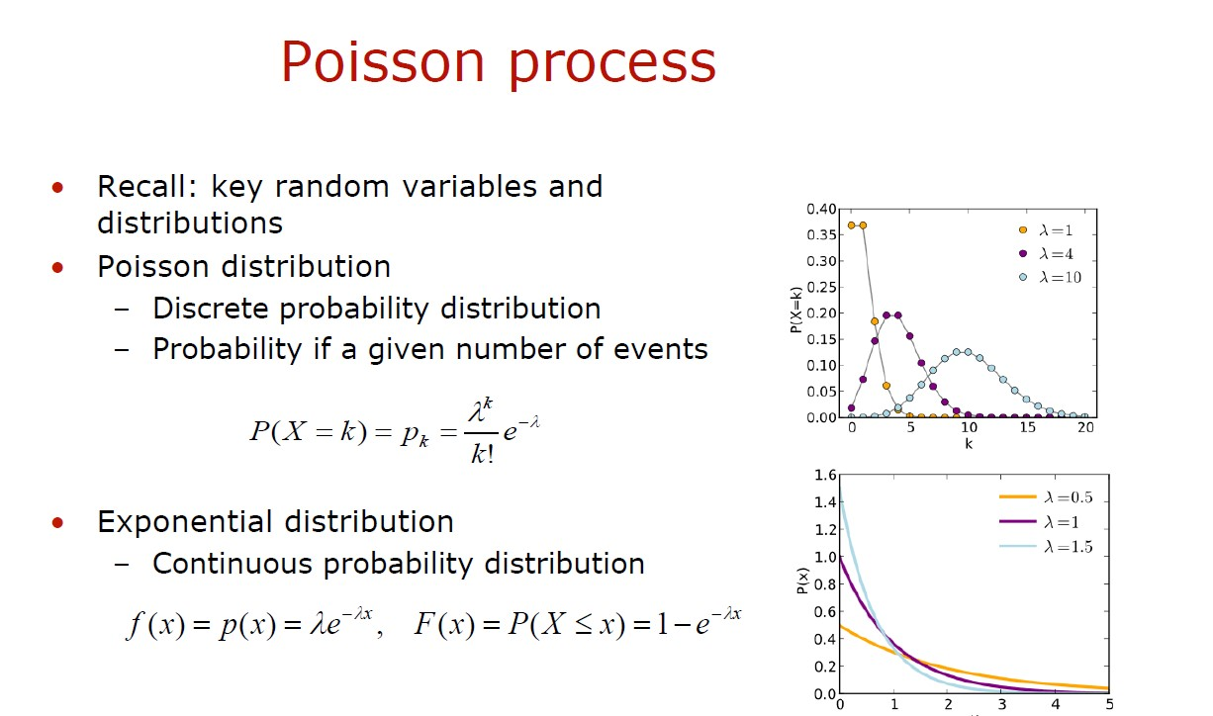

Slide 5
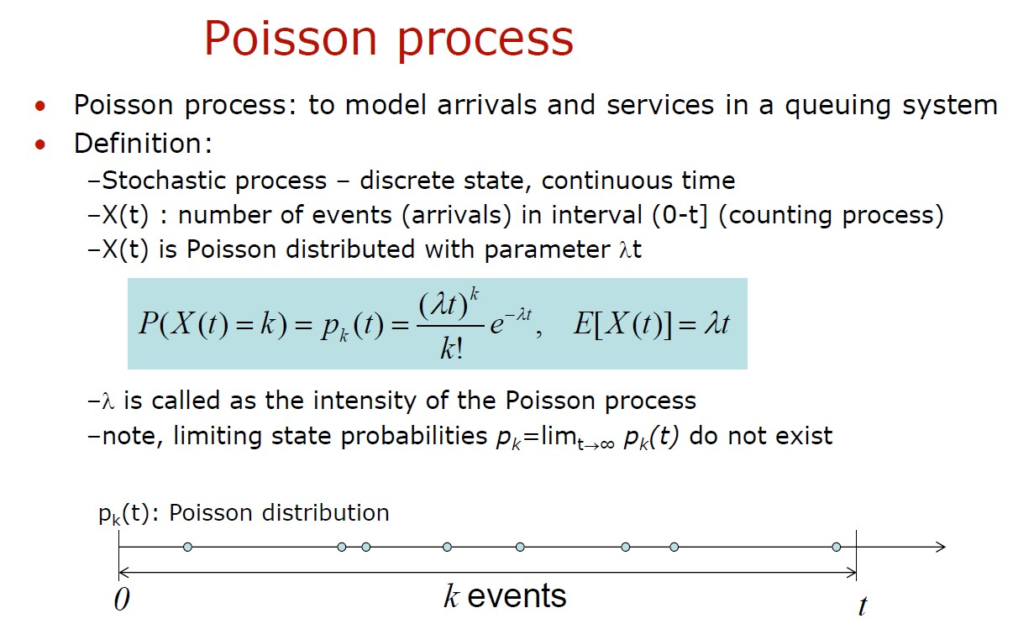

Slide 6
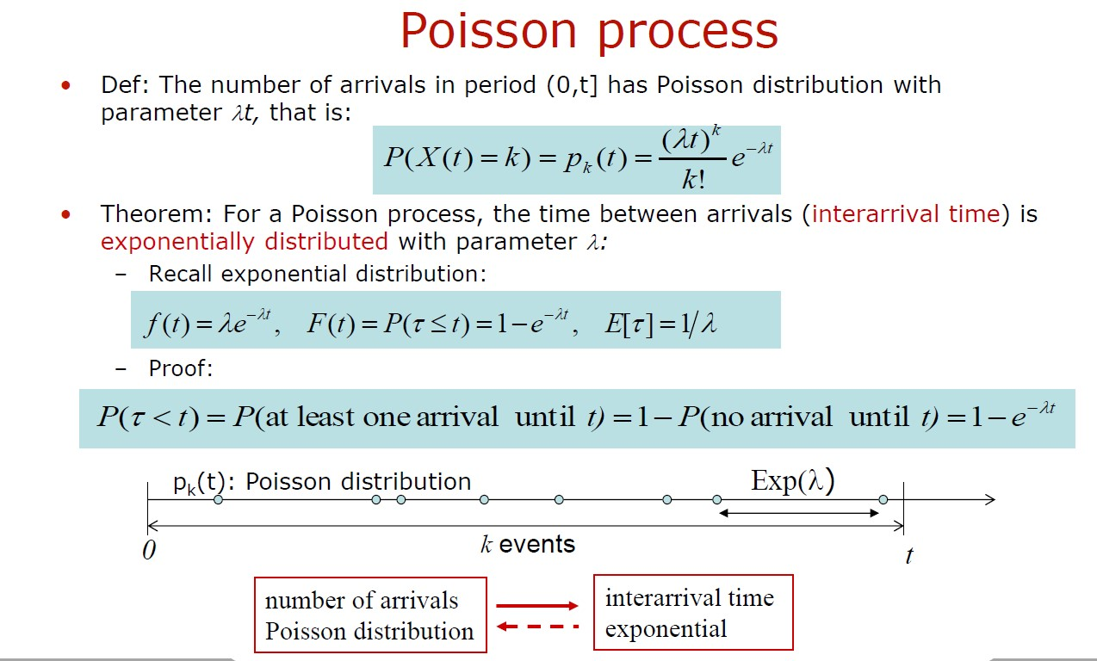

Slide 7
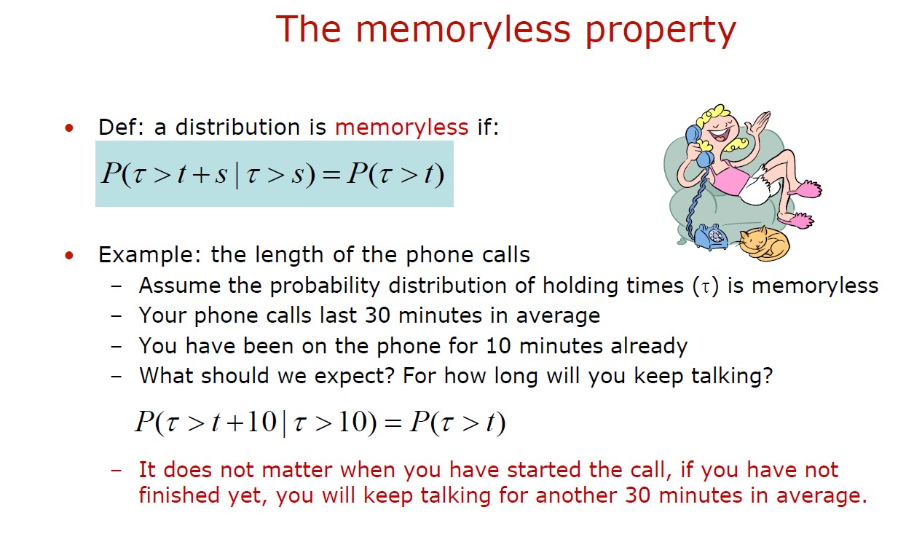

Slide 8
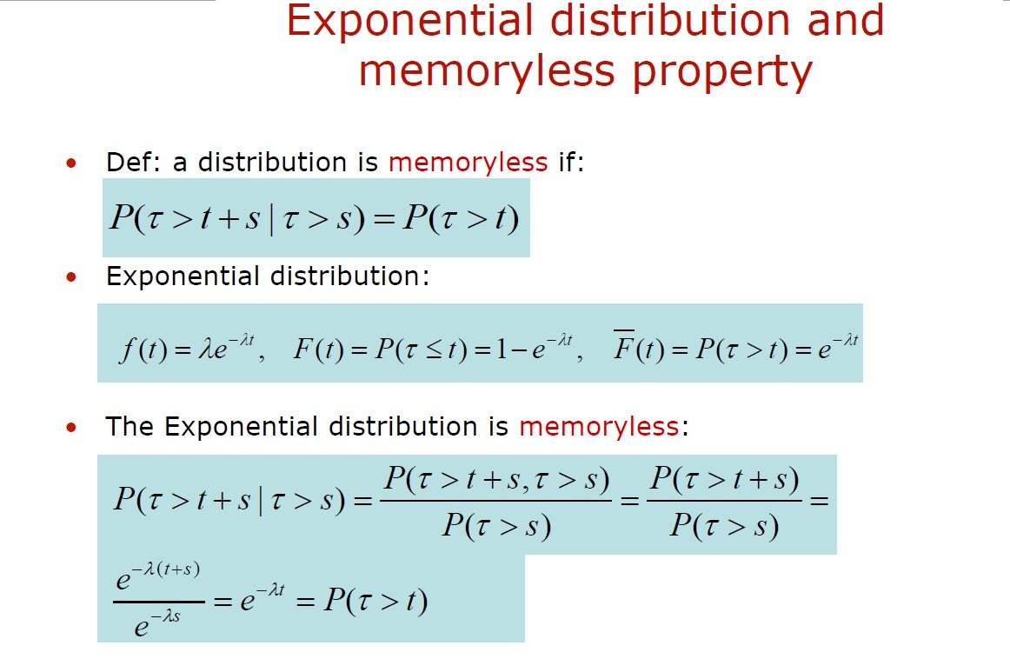

Slide 9
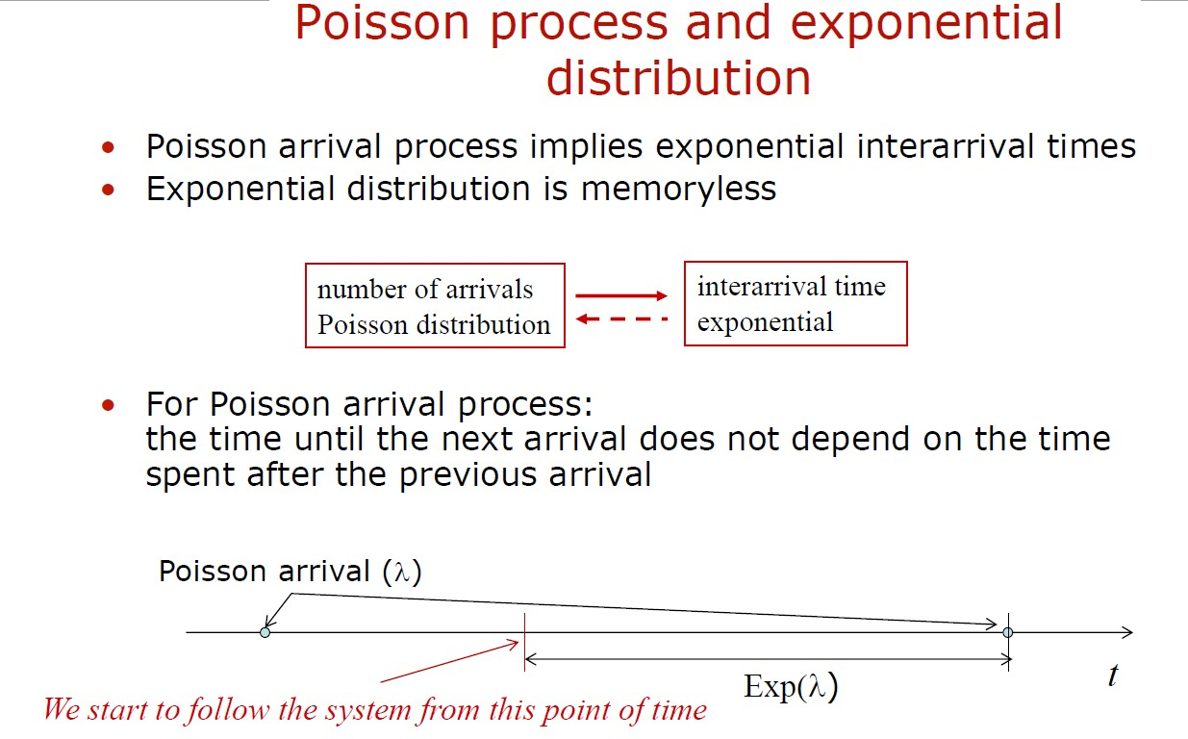

Slide 10
Practice Problems – Poisson Process
Problem 1: A call center receives an average of 5 calls per minute. Assuming the calls arrive according to a Poisson process, calculate the probability that the call center receives exactly 8 calls in a 2-minute interval.
Problem 2: A manufacturing plant experiences, on average, 2 machine failures per day. Assuming machine failures follow a Poisson process, calculate the probability that exactly 4 machine failures occur in a 24-hour period.
Problem 3: A retail store receives an average of 10 customers per hour. Assuming customer arrivals follow a Poisson process, calculate the probability that the store has at least 15 customers in a 2-hour period.

Slide 11
Problem 4: In a computer network, the average number of packets arriving per second is 3. Assuming packet arrivals follow a Poisson process, what is the probability that no packets arrive within a 1-second interval?
Problem 5: A car rental agency receives an average of 2 reservations per hour. Assuming reservations follow a Poisson process, calculate the probability that exactly 3 reservations are made in a 90-minute interval.

Slide 12
Practice Problems – Memory less property
Problem 1:
Suppose the time between phone calls received at a call center follows an exponential distribution with a mean of 10 minutes. What is the probability that the next call will arrive within the next 5 minutes, given that no calls have been received in the past 20 minutes?
Problem 2:
The lifetime of a certain electronic component follows an exponential distribution with a mean of 1000 hours. What is the probability that the component will last for more than 500 additional hours, given that it has already been functioning for 2000 hours?

Slide 13
Problem 3:
The time between arrivals of cars at a drive-thru restaurant follows an exponential distribution with a mean of 3 minutes. What is the probability that the next car will arrive within the next 2 minutes, given that the previous car arrived 5 minutes ago?
Problem 4:
The time between equipment failures in a manufacturing plant follows an exponential distribution with a mean time between failures (MTBF) of 500 hours. The plant has been operating for 1000 hours without experiencing any failures. What is the probability that the next failure will occur within the next 200 hours?

Slide 14
Compound Poisson Process

Slide 15
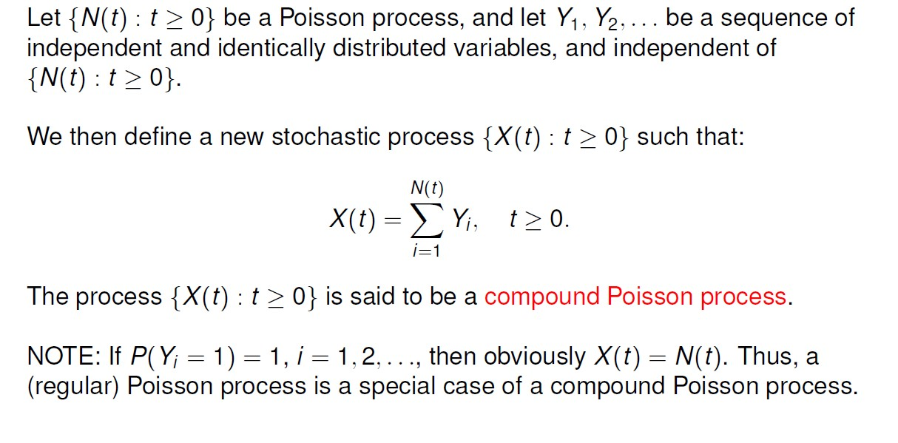
Compound Poisson Process

Slide 16
Example:
In a telecommunications network, the number of errors that occur in a given time interval follows a Poisson process with a rate of 5 errors per minute. Each error requires an average of 2 minutes to be fixed. What is the average number of errors present in a 30-minute interval?
Solution:
The compound Poisson process represents the total number of events occurring in a given time interval. In this case, the number of errors in a 30-minute interval follows a compound Poisson distribution.
The average number of errors in a 30-minute interval can be calculated as the product of the rate of the Poisson process (5 errors per minute) and the duration of the interval (30 minutes).
Therefore:
Average number of errors in a 30-minute interval = λ * t = 5 * 30 = 150
Hence, the average number of errors present in a 30-minute interval is 150.

Slide 17
Slide will be updated soon!
The next section will be the “Markov chains and queuing systems.”

Slide 18
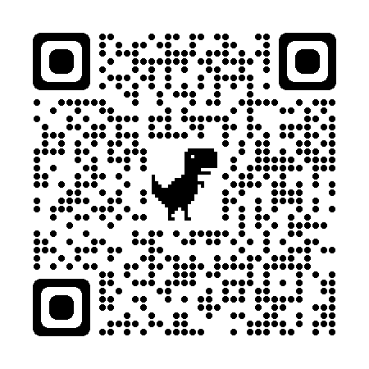

Don’t hesitate to contact us if you have any questions about this course’s teaching contents. Also, don’t forget to check out the course page and Microsoft Team folder,
course page Link: https://mayooran1987.github.io/MC9510/
Course page’s QR code
Microsoft Team folder

